Slide 1
Unlock the Unanswered Secrets of the Product Name Dropped the Of
Scraping, Processing, Analysis and Automatic Generation of Amazon.com Product Reviews
-Markov-Chain title generated from project 4 and project 5 papers
John Feilmeier
dataset of the blades are relly sharp be careful and down

Slide 2
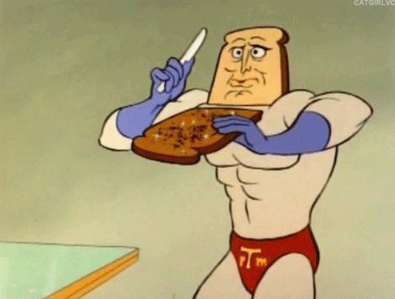
DATA SCRAPING

Slide 3
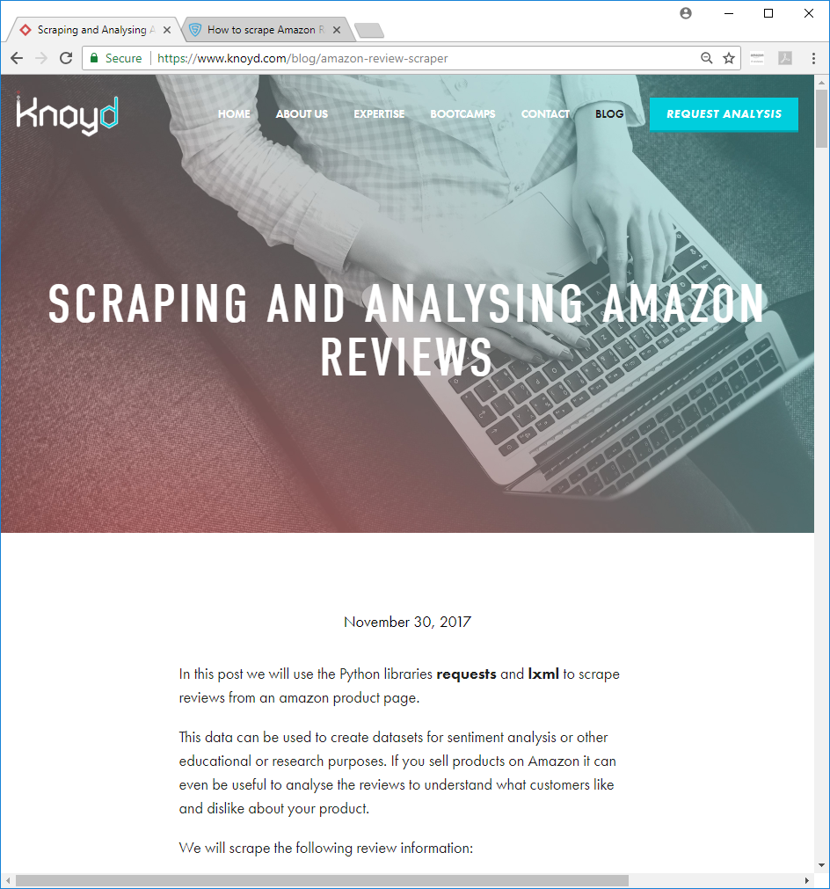
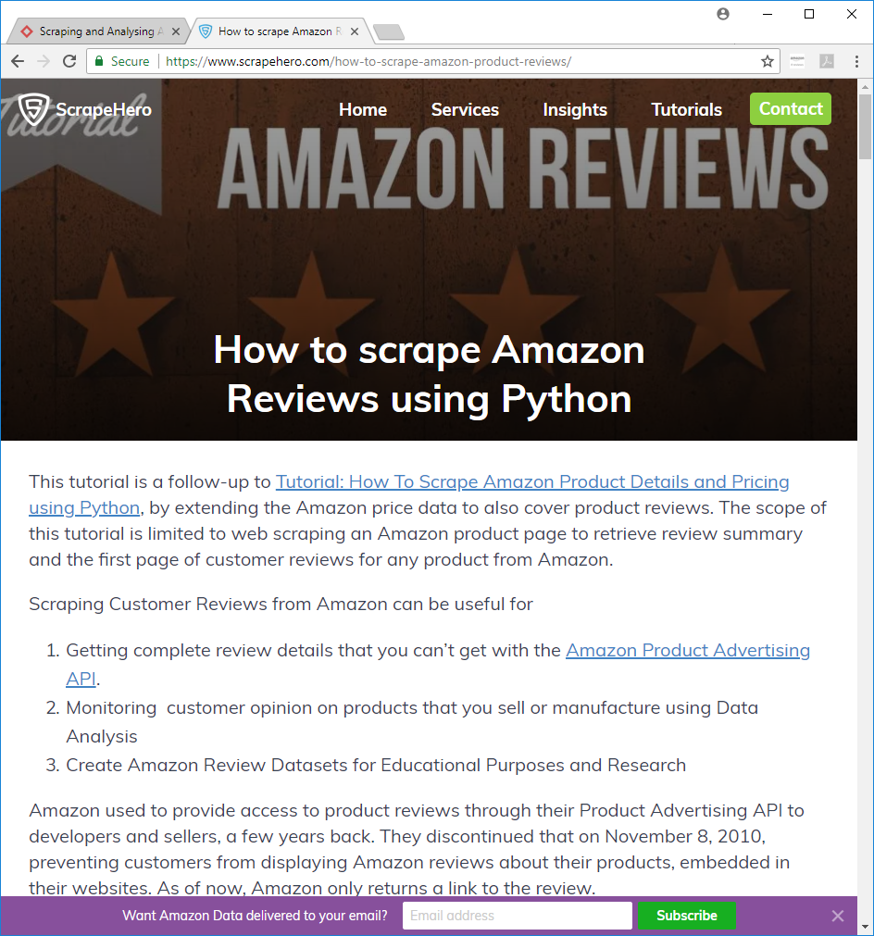

Slide 4
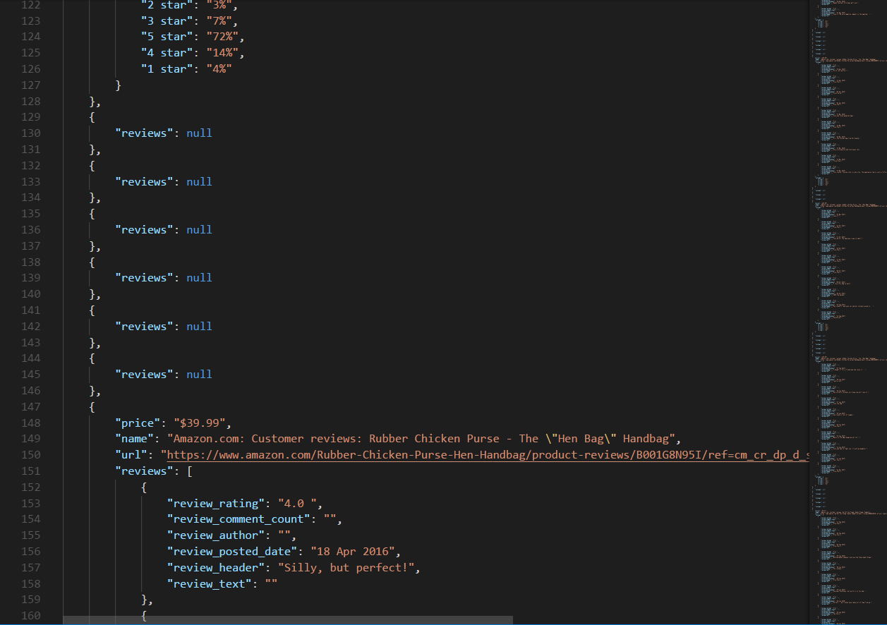

Slide 5
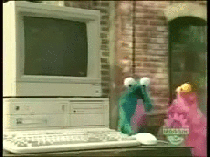
DATA PREPROCESSING

Slide 6
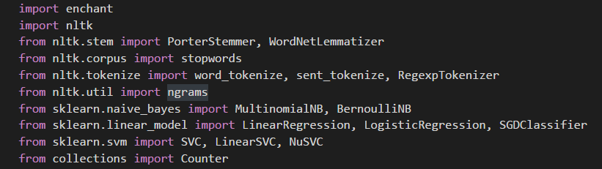
NLTK - Natural Language Tool Kit

Slide 7
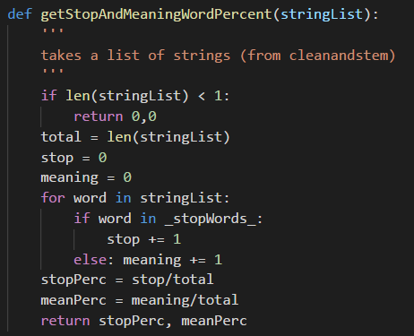
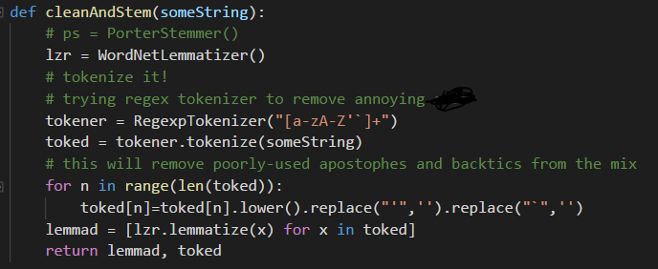

Slide 8
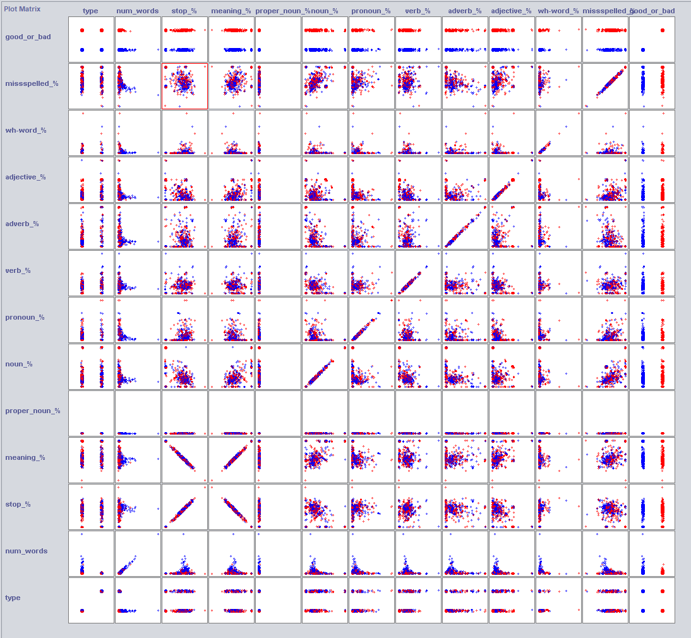
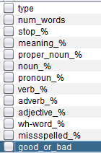

Slide 9
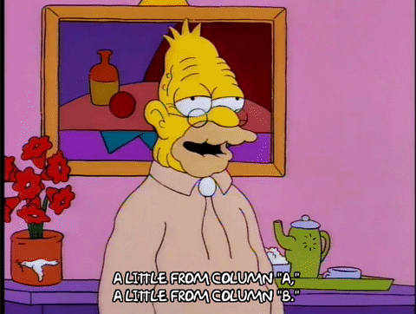
CLASSIFYING THE DATA

Slide 10
METHOD | % CORRECT ON FULL BIGRAM DATA | % CORRECT ON SELECTED ATTRIBUTES IN BIGRAM DATA | % CORRECT ON FULL ‘SMART’ DATA | % CORRECT ON SELECTED ATTRIBUTES IN ‘SMART’ DATA
NaiveBayes | 70.3933 % | 65.99 % | 59.9911 % | 60.0452 %
BayesNet | 70.3933 % | 66.2646 % | 62.3125 % | 60.7289 %
NaiveBayesMultinomial | 73.5314 % | 66.1665 % | 56.9026 % | 59.6911 %
Logistic | 72.7175 % | 66.3528 % | 62.7256 % | 61.2551 %
OneR | 54.3003 % | 54.3003 % | 59.1206 % | 59.1206 %
DecisionTable | 63.9011 % | 64.5092 % | 62.5486 % | 60.5075 %
RandomTree | 67.4512 % | 65.8037 % | 60.1682 % | 59.4206 %
J48 | 71.5505 % | 65.8527 % | 63.6158 % | 60.9649 %
MultilayerPerceptron | 60.1549 % | 64.2542 % | 63.3601 % | 61.7961 %

Slide 11
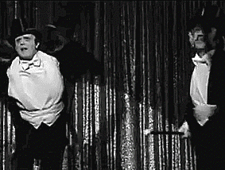
GENERATING NEW DATA

Slide 12
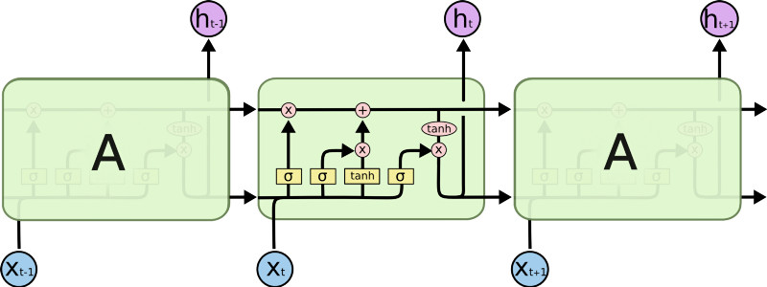
"st book this is a good book but i would recommend having the first one as well if you own the crysta"ld it was a gift for my daughter for a good product i had to return it and the sound quality is a gigt for my daughter and the sound quality is a gigt for my daughter and the sound quality is a gigt for my daughter and the sound quality is a gigt for my daughter and the sound quality is a gigt for my daughter …(7 more lines of this) … and the sound qua

Slide 13
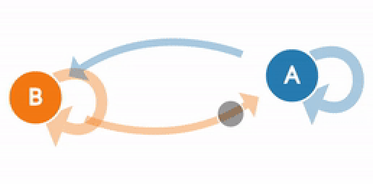
“aren't” so great product works great product you had latex allergies also vinyl is back i thought it was the wine opener sure makes opening a bottle with friends also easier on the counter cabinets unless you take it with my chicken purse i thought but over all clad but actually it's great product especially for the price they really get all the time it should will not create a desktop that doesn't have much than

Slide 14
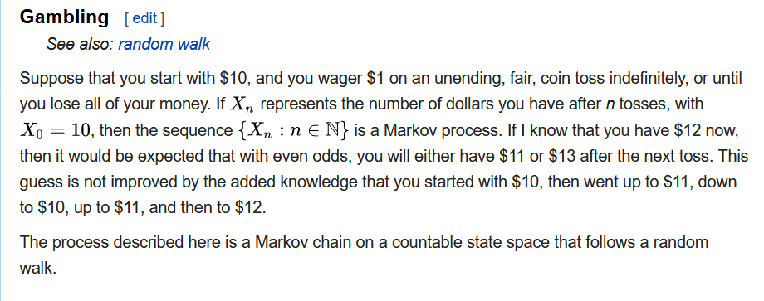
Thanks Wikipedia!

Slide 15

Questions?

